Slide 1
User Generated Content Analytics MIS 381 Attention & influence Fall 2017 (October 17)
Dr. Anitesh Barua
David Bruton Jr. Centennial Chair Professor of Business
Distinguished Fellow, INFORMS Information Systems Society
Stevens Piper Foundation Professor
University of Texas Distinguished Teaching Professor
Associate Director, Center for Research in e-Commerce
McCombs School of Business, The University of Texas at Austin
Email: aniteshb@gmail.com

Slide 2
Finding Influential Social Media Users
Why bother?
What are some necessary attributes?

Slide 3
Analyzing Attention in Social Media: An Example from Twitter
Follower
Friend
You
Follower
Friend
Information
Attention

Slide 4
An Example
@dealtime | Deals galore at www.grabdeals.com
@itsonsale | Huge sale at crazysale.com
@shopnparty | Check out xyz.com for killer bargains.
@beerbudget | RT @itsonsale Huge sale at crazysale.com
@beerbudget | RT @dealtime Deals galore at www.grabdeals.com
@beerbudget | RT @shopnparty Check out xyz.com for killer bargains.
@dealtime | RT@ shopnparty Check out xyz.com for killer bargains.
@itsonsale | RT @shopnparty Check out xyz.com for killer bargains.
@itsonsale | RT @dealtime Deals galore at www.grabdeals.com
@shopnparty | Don’t miss the amazing laptop deal at www.laptops.com
@dealtime | RT @shopnparty Don’t miss the amazing laptop deal at www.laptops.com
@dealtime | Unbelievable offer. Check it out at pennysaver.com
@shopnparty | Super Memorial Day sale coming up at BargainBasement
@beerbudget | RT @dealtime Unbelievable offer. Check it out at pennysaver.com
Copyright Anitesh Barua 2015

Slide 5
How Much Attention Do You Command?
@shopnparty
1
.5
Flow of attention
.25
.5
@itsonsale
.25
@dealtime
.5
@beerbudget
Attention given by to | @shopnparty | @dealtime | @itsonsale | @beerbudget
@shopnparty | - | 0 | 0 | 0
@dealtime | 1 | - | 0 | 0
@itsonsale | .5 | .5 | - | 0
@beerbudget | .25 | .5 | .25 | -
Total attention received | 1.75/3 = 58.33% | 33.33% | 8.33%
Copyright Anitesh Barua 2015

Slide 6
Other Factors That Determine Influence?

Slide 7
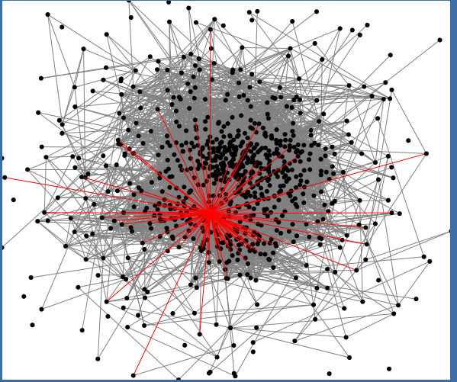
Your Network Location
In addition to getting attention & being active, your position in a network matters
Who are most popular?
Who are “best” connected?
Who can help spread a message?
Who can help connect diverse groups?
Who’s that guy?
Copyright Anitesh Barua 2017

Slide 8
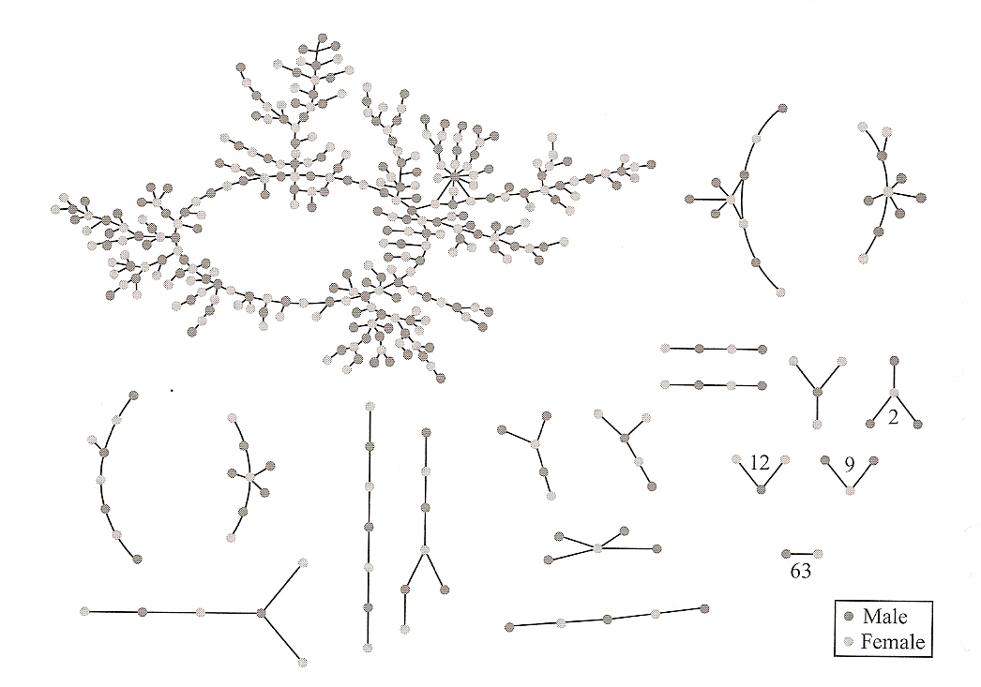
Network Structure
Can we learn from epidemiology?
Source: “Networks, Crowds and Markets”

Slide 9
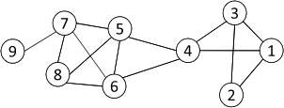
Metrics: Degree Centrality
Who are most popular? Most connected?
Number of “edges” connected to a “node” or “vertex”
Normalized Degree Centrality: Degree centrality/(n -1)
For node 1, degree centrality is 3;
Normalized degree centrality is
3/(9-1)=3/8.
In-degree and out-degree for directed networks (e.g., Twitter, email, etc.)
Can degree be a useful metric?

Slide 10
Metric: Betweenness Centrality
Popularity is useful, but there are other important roles
Connecting disparate parts of a network
How difficult will it be for others (esp. at the “outskirts”) to communicate without you in the network?
Nodes with high betweenness are important in transmitting new information, ideas & opportunities to a wide audience

Slide 11
Metric: Betweenness Centrality
Popularity is important, but there are other important roles
Connecting disparate parts of a network
Nodes with high betweenness are important in transmitting new information, ideas & opportunities.

Slide 12
Betweenness Centrality Example
5
2
10
1
9
7
4
 | 1 | 2 | 3 | 4 | 5 | 6 | 7 | 9 | 10
1 | -
2 |  | -
3 |  |  | -
4 |  |  |  | -
5 |  |  |  |  | -
6 |  |  |  |  |  | -
7 |  |  |  |  |  |  | -
9 |  |  |  |  |  |  |  | -
10 |  |  |  |  |  |  |  |  | -
8
3
6

Slide 13
Metric: Closeness Centrality
Some nodes can reach the whole network more quickly than other nodes
How close a node is to all other nodes
Create a matrix of shortest (geodesic) distances between nodes
Average distance between a node and all other nodes
1/average distance is the closeness centrality of the node

Slide 14
Closeness Centrality Example
5
2
10
1
9
7
4
 | 1 | 2 | 3 | 4 | 5 | 6 | 7 | 8 | 9 | 10
1
2
3
4
5
6
7
8
9
10
8
3
6

Slide 15
Metric: Eigenvector Centrality
One’s importance is partly determined by “the company one keeps”
If one has many important friends, s/he should be important ☺
Eigenvector centrality considers not only your degree, but your friends’ degree
I.e., are your friends connected to large networks?
A variant of this eigenvector centrality is Google’s PageRank

